Slide 1



Job search process and strategies
Presented by
Md. Parvej - 191902067
Jahid Hasan - 193902001
Jakiyatun Naima- 193902013
Mahbub Al Suprove Meshbah -193902016
Azmary Akter-193902019
Department of CSE Green University of Bangladesh Permanent Campus

Slide 2
CONTENT
Build an online portfolio or an “About me” page
Try to predict the interview questions
Share your knowledge on LinkedIn
Define your expectations.
Network whenever possible
Contact companies directly
Create a timeline and reward yourself
Pay attention to job title variations
Job search process and strategies

Slide 3
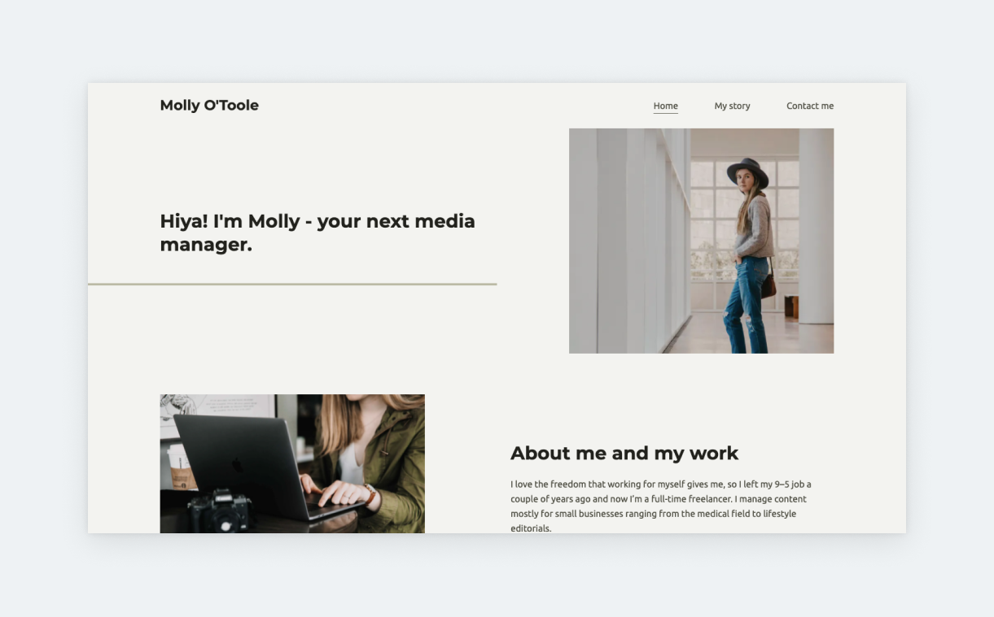
Build an online portfolio
While online portfolios are a standard among designers and software developers, they’re great for other professionals, too. For example, if you’re a copywriter, you can add some of your best writing. Or, if you’re a video editor, you can share links to the clips you’ve produced.
Job search process and strategies

Slide 4

Try to predict the interview questions
Most Common Job Interview Questions:
Tell me something about yourself.
How did you hear about this position?
Why do you want to work here?
Why did you decide to apply for this position?
What is your greatest strength?
What are your strengths and weaknesses?
What do you know about this company/organization?
Job search process and strategies

Slide 5

Share knowledge on LinkedIn.
Scenario: Wouldn’t it be great, if instead of looking for a job, the right opportunity “knocked on your door”?
is it possible?
Job search process and strategies

Slide 6

Define expectations
Are you interested in a full-time, part-time, or freelance role?
Are you happy to be office-based, or is working remotely your preferred option?
Job search process and strategies

Slide 7

Network whenever possible
Networking is a crucial aspect of the job search process. It involves building and maintaining relationships with professionals in your industry or desired field.
Job search process and strategies

Slide 8

Contact companies directly
Contacting companies directly is an effective strategy in the job search process. It allows us to proactively reach out to organizations that interest us, even if they haven't advertised any job openings.
Job search process and strategies

Slide 9

Create a timeline and reward yourself
Creating a timeline and rewarding ourselves during the job search process can help us to stay organized, motivated and focused on our goals. We can assign rewards to each milestone or task we accomplish.
Job search process and strategies

Slide 10

Pay attention to job title variations
Paying attention to job title variations is an important strategy during the job search process. It helps us to broaden our search and uncover relevant opportunities that may be advertised under different job titles.
Job search process and strategies

Slide 11

Design and Development Smart Weather Application

